Slide 1
KVRAID: High Performance, Write Efficient, Update Friendly Erasure Coding Scheme for KV-SSDs
Qin, M., Reddy, A. N., Gratz, P. V., Pitchumani, R., & Ki, Y. S.
In Proceedings of the 14th ACM International Conference on Systems and Storage (pp. 1-12). {SYSTOR’21}
이광희
kwanghee0124@dankook.ac.kr
2021. 08. 09

Slide 2
Introduction
Background
Motivation
Design
Implementation
Evaluation
Conclusions

Slide 3
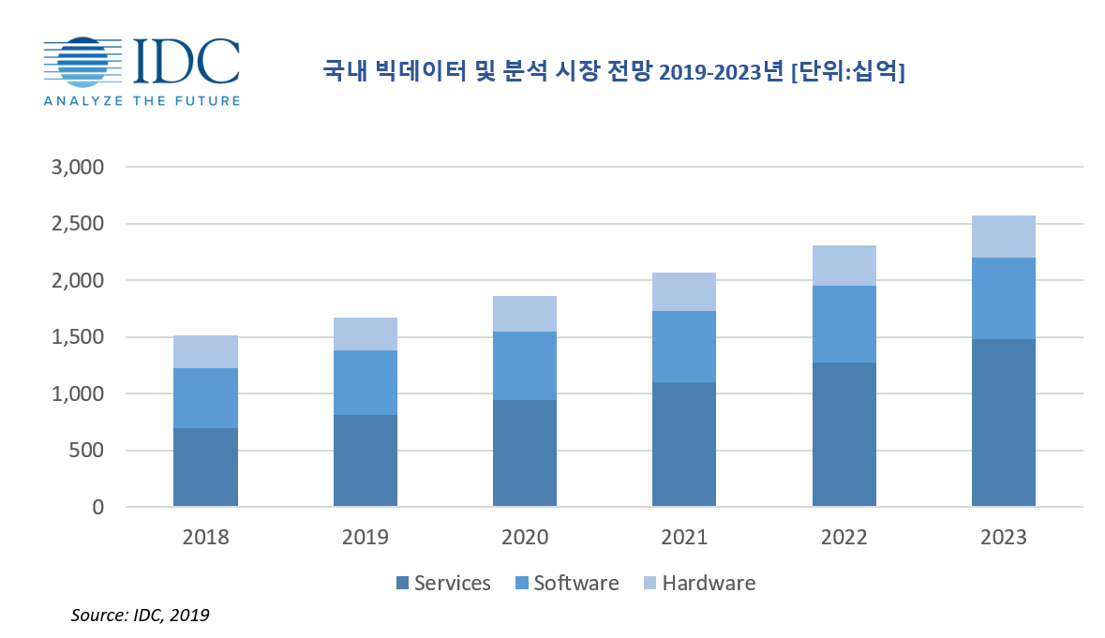
1. Introduction
Rise of unstructured data
Social media, IoT, etc.

Slide 4

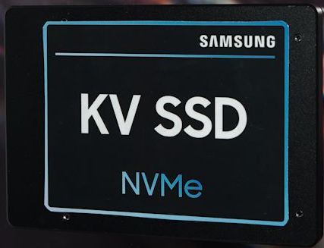

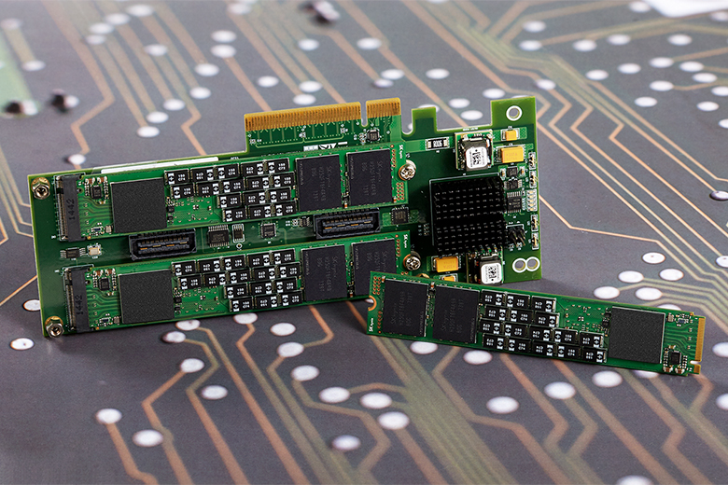
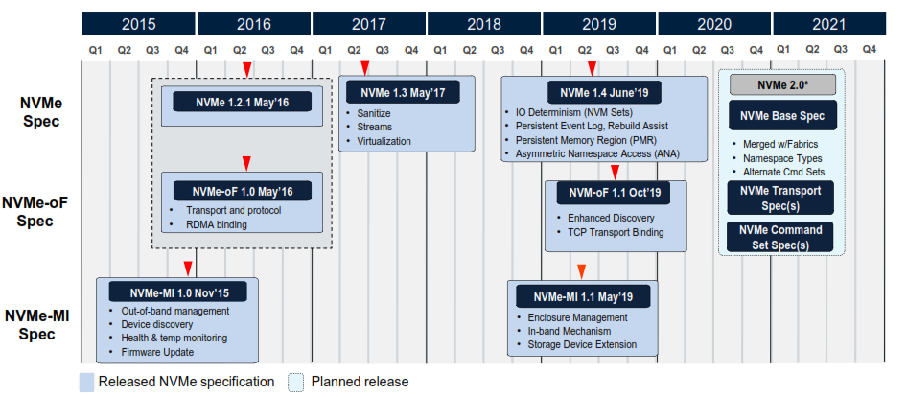
1. Introduction
Next generation storage
SATA SSD
NVMe SSD
ZNS SSD
Key-value SSD
Key-value I/O Interface
New NVMe Command Set
=> NVMe Key Value (NVMe-KV) Command Set

Slide 5
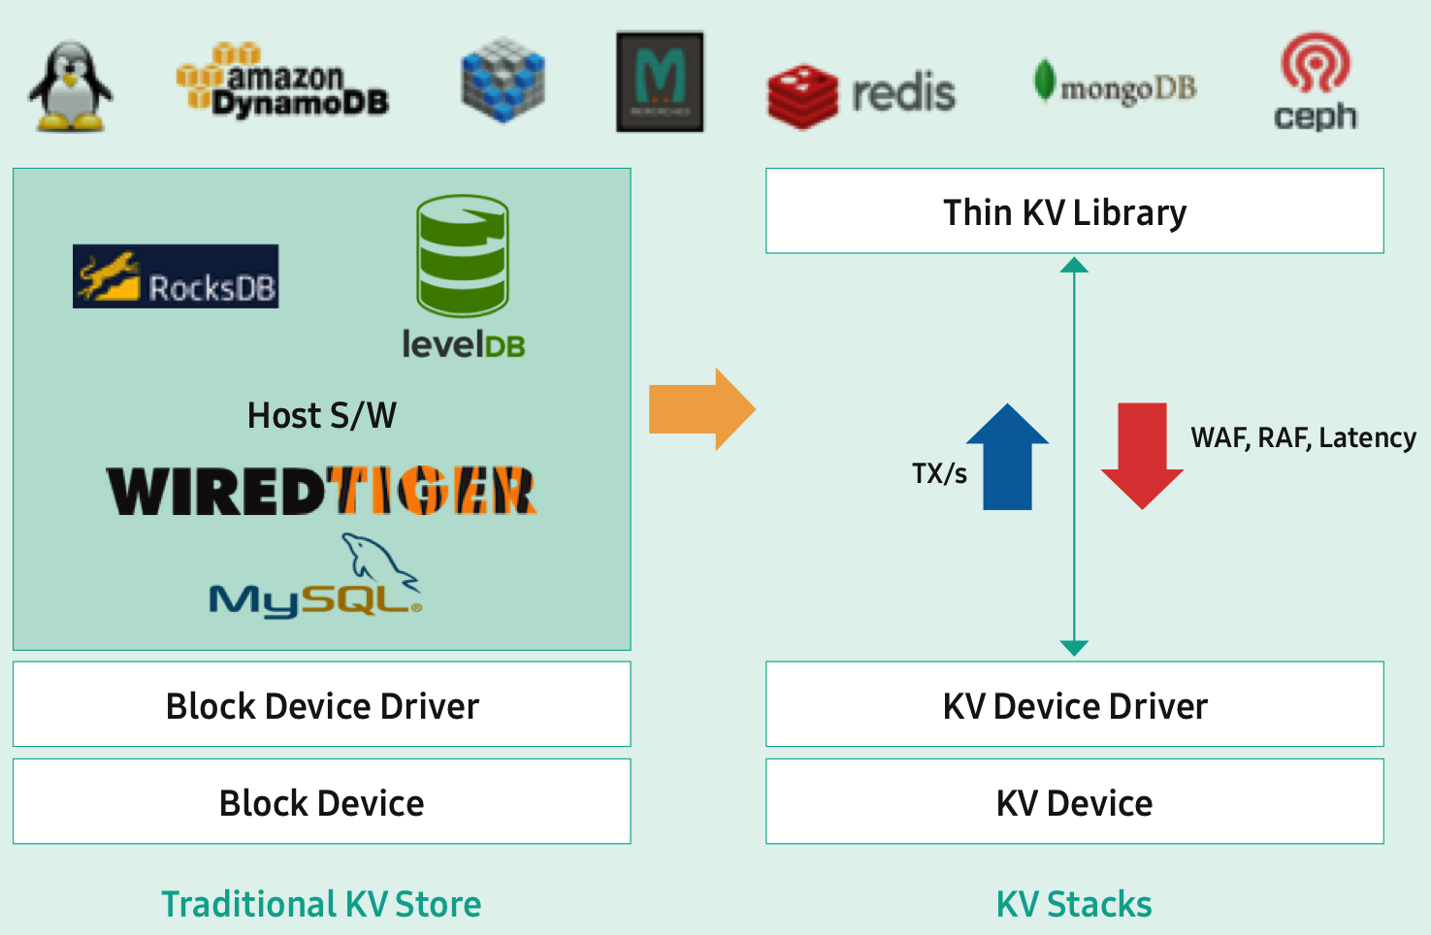
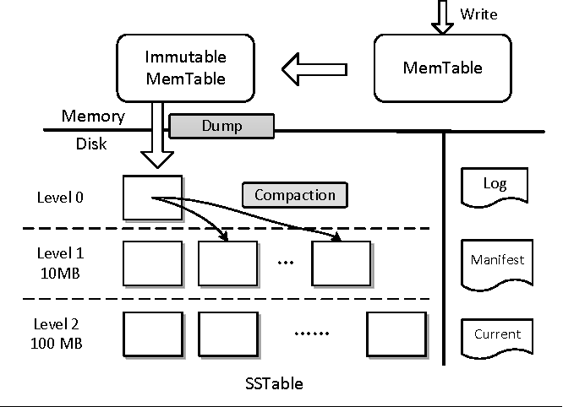
2. Background
SW KV Store(LevelDB, RocksDB ) vs KVSSD
Source: Samsung ppt

Slide 6

2. Background
Distributed object storage
Replication(3 copy), Erase code(EC)
Encoding
Data
Data
Data
Parity
Parity
Parity
Data
K data chunks
M parity chunks
copy
Data
Data
Data
Decoding
Parity
Parity
Parity
Erased and surviving chunks
Rebuild chunks

Slide 7
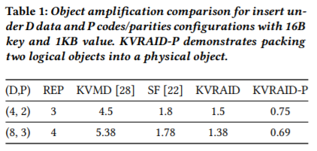
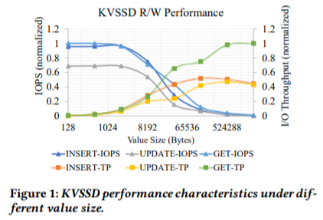
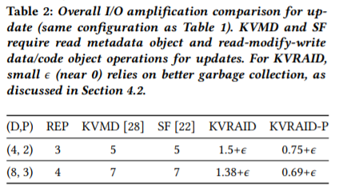
3. Motivation

Slide 8
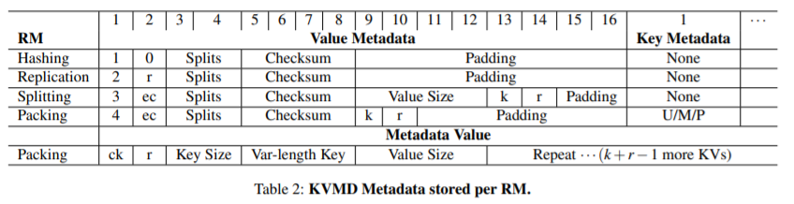
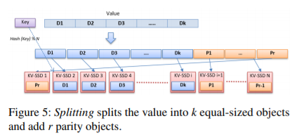
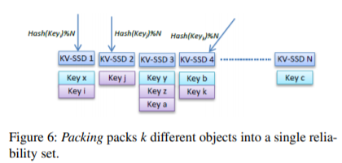
3. Motivation - KVMD
Source: KVMD paper, FAST’20

Slide 9
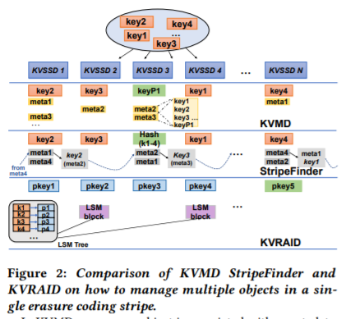
3. Motivation

Slide 10
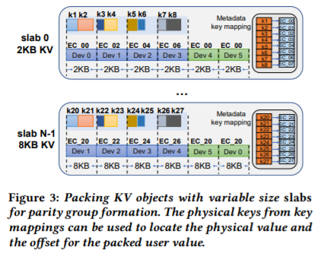
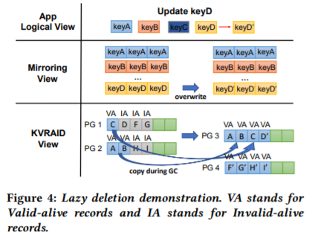
4. Design
Parity group formation with packing
Slab allocator
Batch writes - small data
Grouping
Lazy deletion

Slide 11
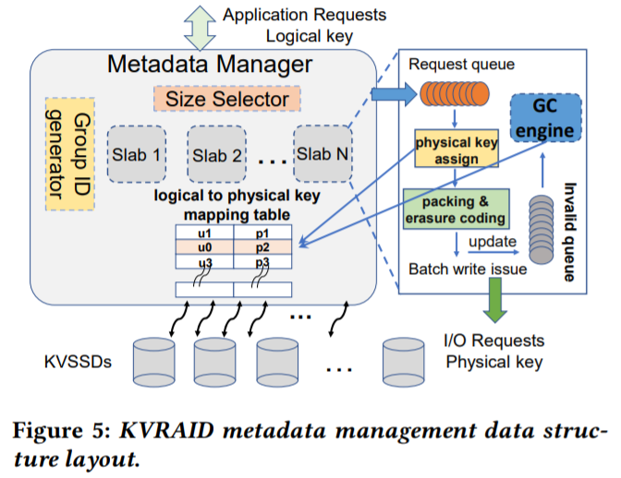
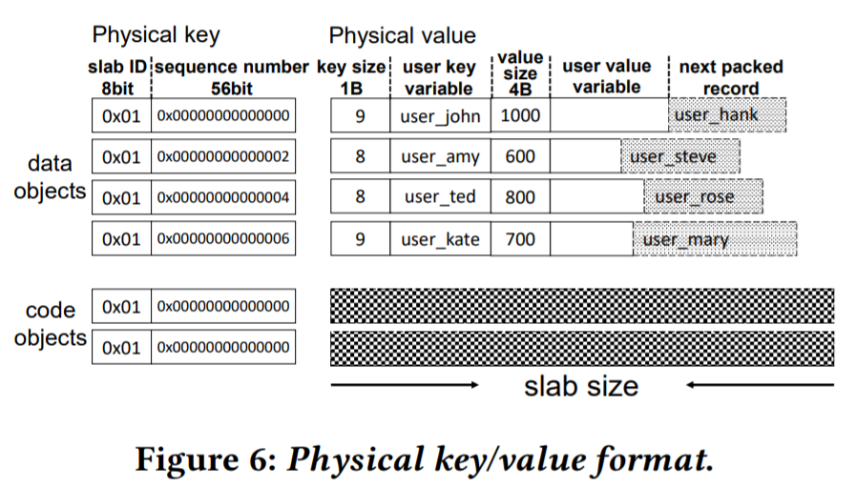
5. Implementation
Metadata management
Slab
Group id x k + offset x p
k: number of data objects
p: number of records packed
Mapping table
1) NVM, 2) LSM-tree
Invalid queue

Slide 12
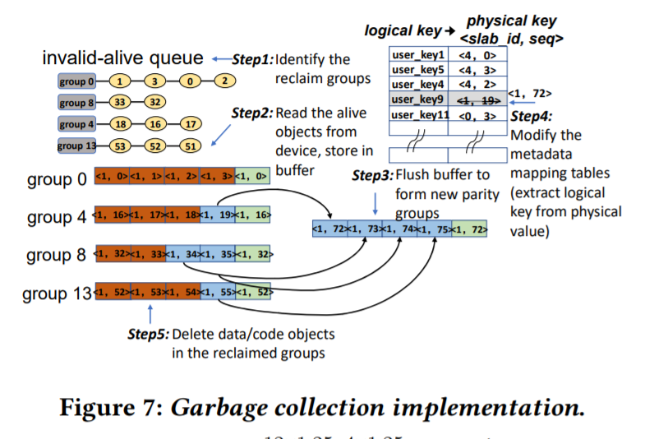
5. Implementation
Metadata management
Invalid queue
Garbage collection

Slide 13
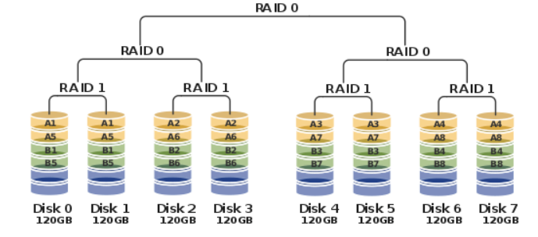
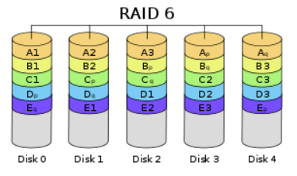
6. Evaluation
Configuration
Comparison schemes
RocksDB-raid10
RocksDB-raid6
Mirroring
Small write IS(KVMD)
Batch writes IS
Batch write, Lazy deletion
Metadata - Storage
Batch writes IM
Batch write, Lazy deletion
Metadata - Memory
Batch writes pack IM
+ Packing 2 objects
Compression | RAID 6 | Cache | Value size range
Compression disabled | 4 data 2 parity | RocksDB: Block cache KVRAID: LRU cache | 100B to 4000B

Slide 14
6. Evaluation
Workload - YCSB
Threads | Distribution | Workloads | Value size range | Records
64 | Zipfian | Default workloads Update/Get (90:10) (70:30) (50:50) (30:70) (10:90) | 100B to 4000B | 200 million (약 400GB)
Notes:
2억개

Slide 15
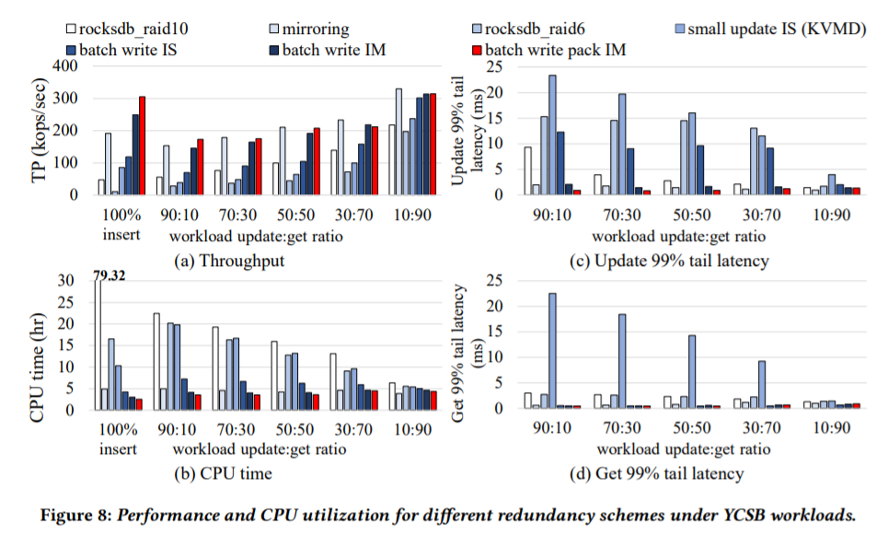
6. Evaluation

Slide 16
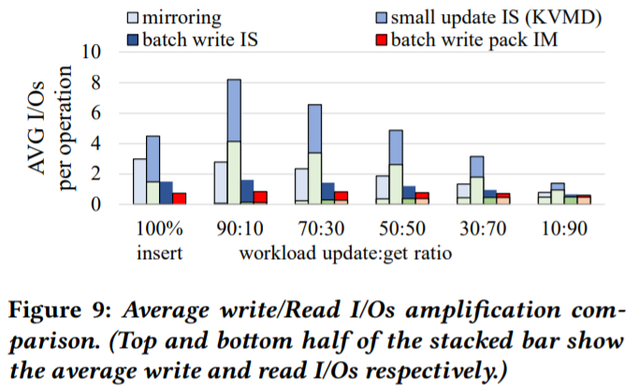
6. Evaluation

Slide 17
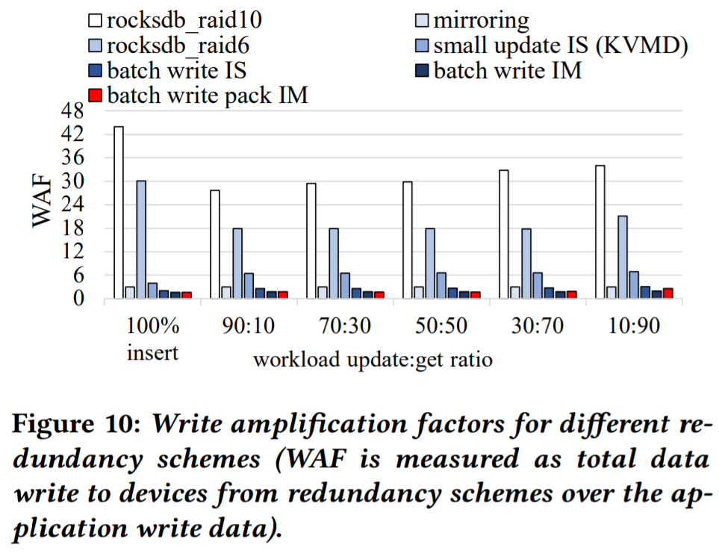
6. Evaluation

Slide 18

7. Conclusion
KVRAID
Erasure coding-based redundancy scheme for KVSSDs.
Handle variable key-value object lengths
Parity code - Slab allocator
Small value size - Grouping
Batch write, Lazy deletion, Garbage collection
High performance, low write amplification

Slide 19
Thank You!
2021. 08. 09

